Slide 1
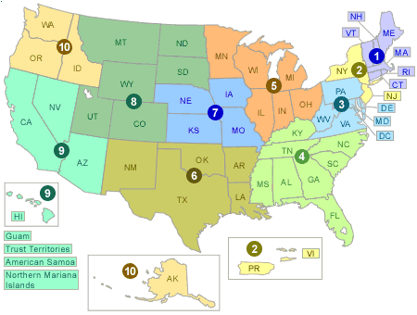
Mission: To protect human health and
safeguard the environment
National Program Offices:
Air and Radiation
Chemical Safety and Pollution Prevention
Enforcement and Compliance Assurance
Environmental Information
General Counsel
International and Tribal Affairs
Land and Emergency Management
Water
Research and Development
EPA Office of Research and Development - National Research Programs
Air, Climate & Energy
Sustainable & Healthy Communities
Homeland Security
10 Regional EPA Offices
(plus labs and field offices)
Chemical Safety for Sustainability
Human Health Risk Assessment
Safe & Sustainable
Water Resources

Slide 2
What We Have to Offer
Natural Resource Expertise
Tools and Products
Landscape Ecology
Conservation & Wildlife Biology
Wetland & Aquatic Ecology/Biology
(including monitoring)
Watershed Analysis/Modeling
Water Quality/Chemistry
(including monitoring)
Ecosystem Service Valuation
Toxicology
Ecological and Human Health Risk
Assessment
Systems/Cumulative Effects Analysis
Climate Change Science
National Aquatic Resource Surveys (NARS): assesses the status of and changes in quality of the nation’s coastal waters, lakes and reservoirs, rivers and streams, and wetlands
EnviroAtlas: interactive tools and information for exploring the benefits we receive from "ecosystem goods and services“; and to access, view, and analyze diverse information to better understand the potential impacts of various decisions
Multi-criteria Integrated Resource Assessment: facilitates stakeholder engagement and science integration for collaborative multi-objective decision making.

Slide 3
Opportunities for Collaboration
LCC Partners Expertise, Data/Information and
Tools Needed for:
Making a Visible Difference in Communities (assessments, strategic planning, indicators/metrics, ecosystem service valuation, environment/human health nexus)
Regional “Geographic” Programs, inc. National Estuary Programs, Urban Waters Programs
Project Impact Review (inc. cumulative impact analyses) for regulatory programs (NEPA, Section 404 permits, NPDES Discharge permits, etc.)
Provide “Context” for site-level protection and restoration
Developing Climate Adaptation/Resiliency Strategies
Regional Watershed and Landscape Assessments (inc. Ecological Risk Assessments)

Slide 4
Opportunities for Collaboration
Federal multiagency (DOE, DOI) coordination on research associated with unconventional oil and gas resources (shale gas, oil, hydraulic fracturing, etc.)
Collaborations with private orgs and public agencies to promote EPA Healthy Watershed Initiatives
Enhance resilience/climate adaptation through natural resource planning, management, and research, across state and federal agencies (NOAA, FEMA, DOD, BLM, NPS, USGS, ACOE, DOI, USDA) using geographic and regional approaches facilitated by the LCCs

